Slide 1
Entity Relational Model
Session 02
Rico Halim, S.Kom., M.Kom.

Slide 2
Learning Outcomes
Session 2
At the end of this session, students will be able to:
LO-1 : Define model data and information in the form of conceptual and apply them to the DBMS, both individually and in teamwork.

Slide 3
outline
Session 2
Data Model
Entity & Attributes
ERD Notation
Relationships & Cardinality
SQL Overview (Preview)

Slide 4
DATA MODEL
What is a Data Model?
A data model is a collection of concepts used to describe the structure of a database, including data types, relationships, and constraints.
Think of it this way:
An architect draws a blueprint before building a house.
A data model is the blueprint for your database.

Slide 5
DATA MODEL
Three Levels of Data Model
Conceptual
  Describes WHAT data is stored.
  Entities and relationships only, no technical detail.
Logical
  Describes HOW data is structured.
  Tables, columns, keys. DBMS-independent.
Physical
  Describes WHERE data is stored.
  Data types, indexes, storage. DBMS-specific.

Slide 6
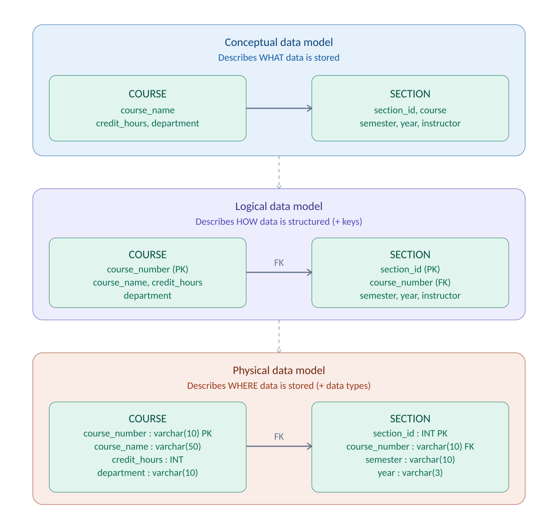
DATA MODEL
Three Levels in Action

Slide 7
DATA MODEL
Components of a Data Model
Entity
  A real-world object or concept.
  Example: Student, Course, Employee.
Attribute
  A property that describes an entity.
  Example: student_id, name, birth_date
Relationship
  An association between two or more entities.
  Example: a Student "enrolls in" a Course.

Slide 8
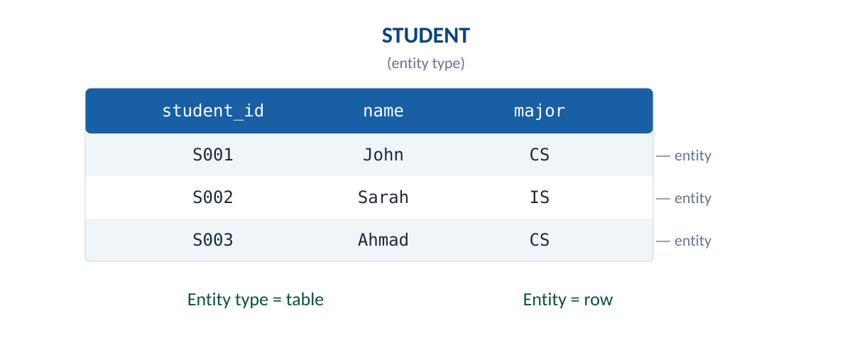
ENTITY & ATTRIBUTES
Entity and Entity Type
Entity type: a collection of entities that share the same attributes.
Entity: a specific instance of an entity type.

Slide 9
ENTITY & ATTRIBUTES
Attribute Types
Key
  Uniquely identifies each entity. Example: student_id
Composite
  Can be divided into smaller subparts. Example: name -> first, middle, last
Multivalued
  Can hold multiple values for one entity. Example: skills, phone_numbers
Derived
  Calculated from other attributes, not stored. Example: age (from birth_date)

Slide 10
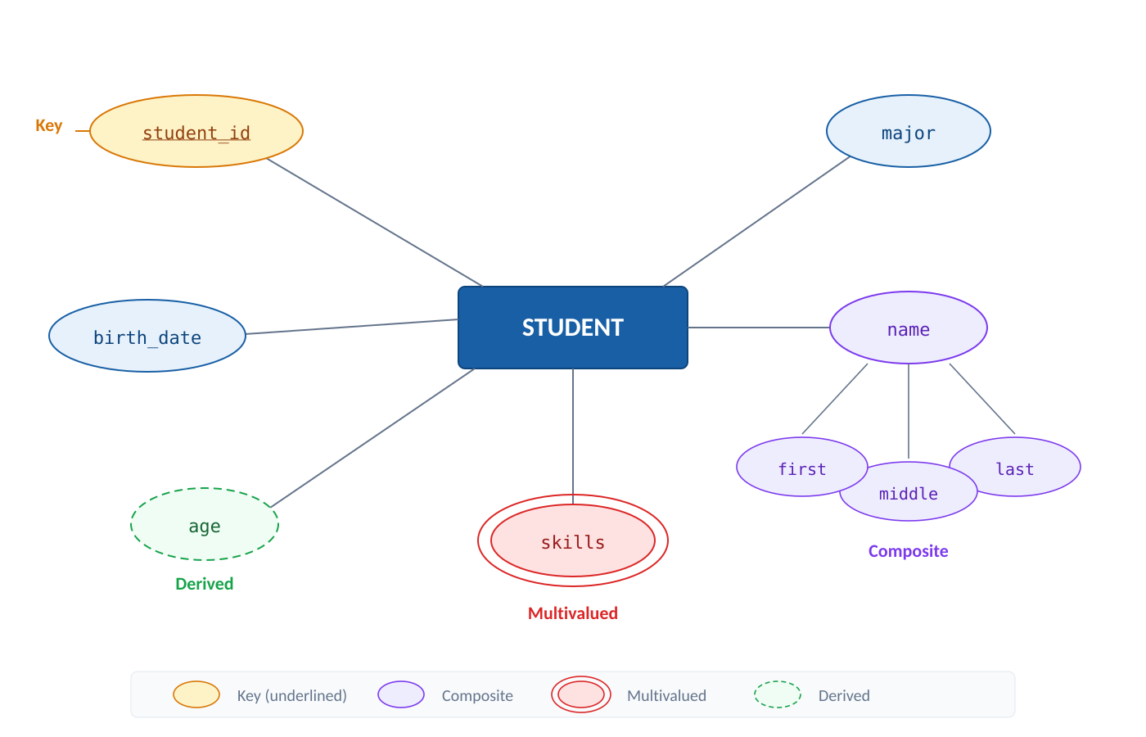
ENTITY & ATTRIBUTES
Attribute Types

Slide 11
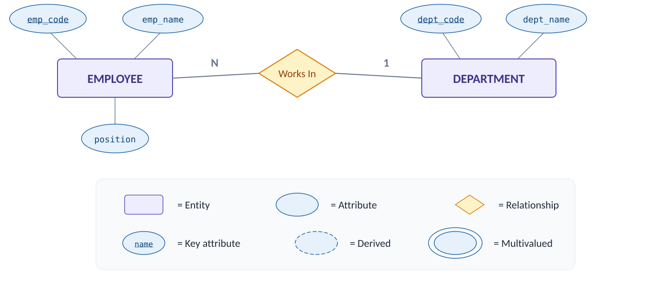
ERD NOTATION
Chen Notation
  Developed by Peter Chen (1976). Uses a diagrammatic approach to represent ER models.

Slide 12
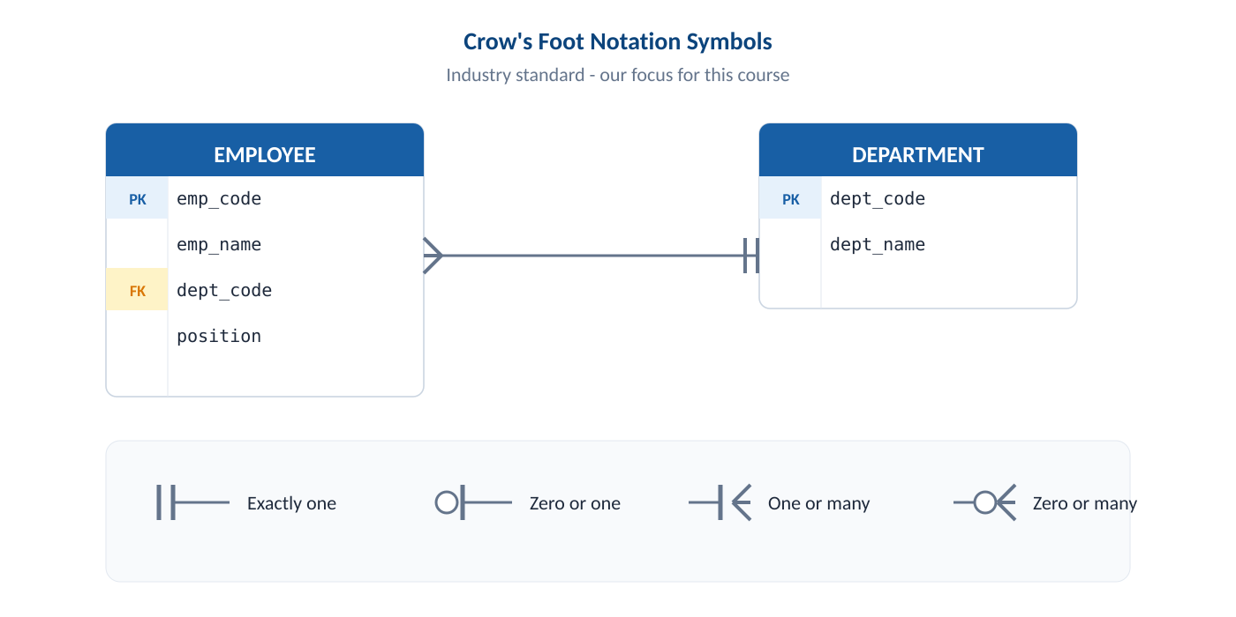
ERD NOTATION
Crow's Foot Notation
  Attributes are listed inside the entity box. PK and FK are clearly marked. Relationships are shown as lines with symbols at each end.

Slide 13
RELATIONSHIPS & CARDINALITY
Relationship
  A relationship is an association between two or more entities. Example:
  a Student "enrolls in" a Course
  an Employee "works in" a Department
Degree of a relationship:
Binary: between 2 entities (most common)
Unary: an entity related to itself. e.g. an Employee "supervises" another Employee
Ternary: between 3 entities (rare)

Slide 14
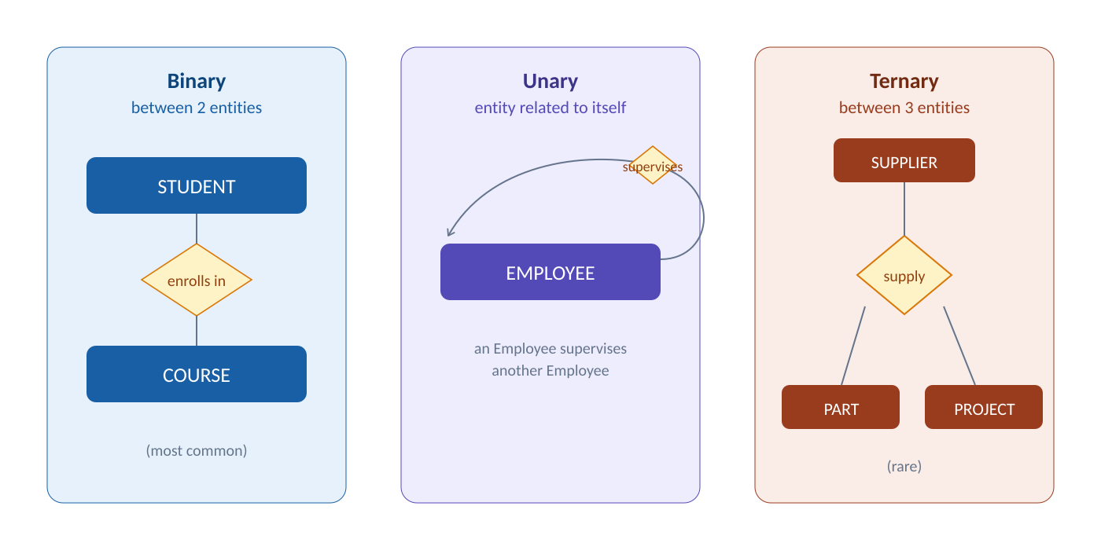
RELATIONSHIPS & CARDINALITY
Relationship

Slide 15
RELATIONSHIPS & CARDINALITY
Cardinality
  Cardinality defines how many instances of one entity can be associated with instances of another entity.
  Three types:
  One-to-One (1:1)
  One-to-Many (1:N)
  Many-to-Many (M:N)

Slide 16
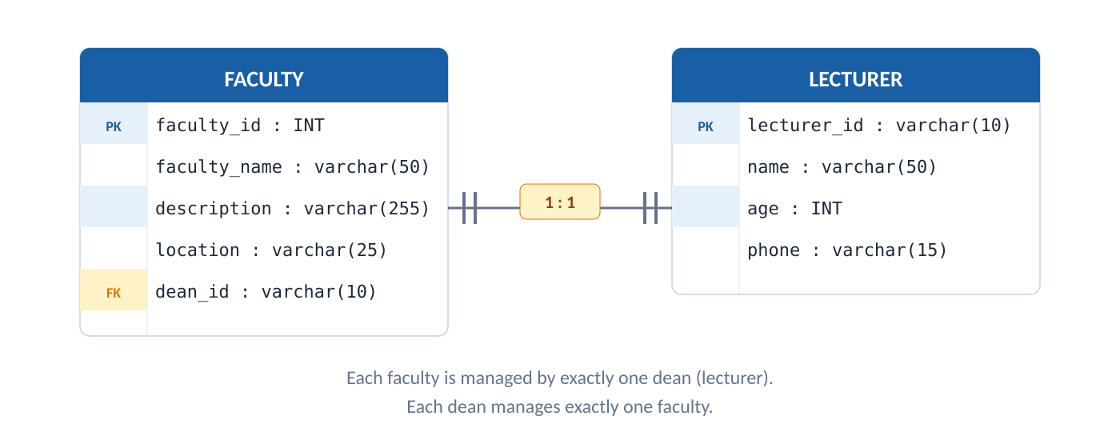
RELATIONSHIPS & CARDINALITY
One-to-One Relationship (1:1)
One instance of entity A is associated with exactly one instance of entity B. Example: In a university, each faculty is managed by exactly one dean (lecturer).

Slide 17
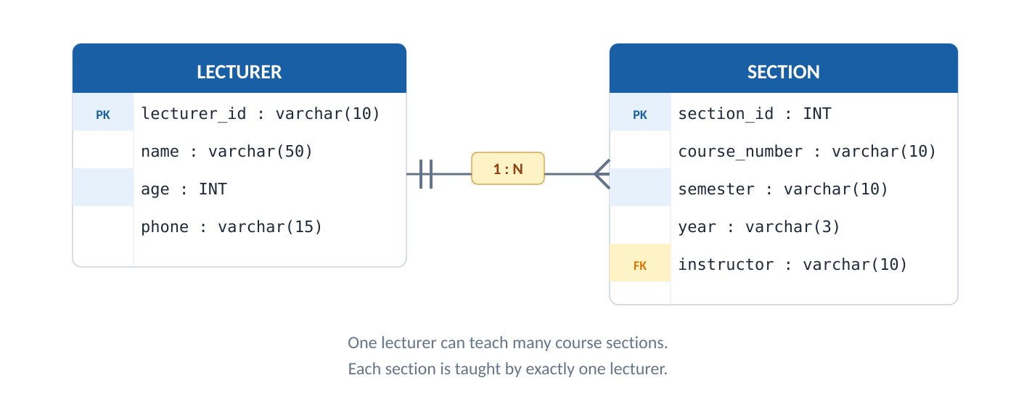
RELATIONSHIPS & CARDINALITY
One-to-many Relationship (1:N)
One instance of entity A can be associated with many instances of entity B, but each instance of B is associated with exactly one instance of A.
Example: In a university, one lecturer can teach many course sections. Each section is taught by exactly one lecturer.

Slide 18
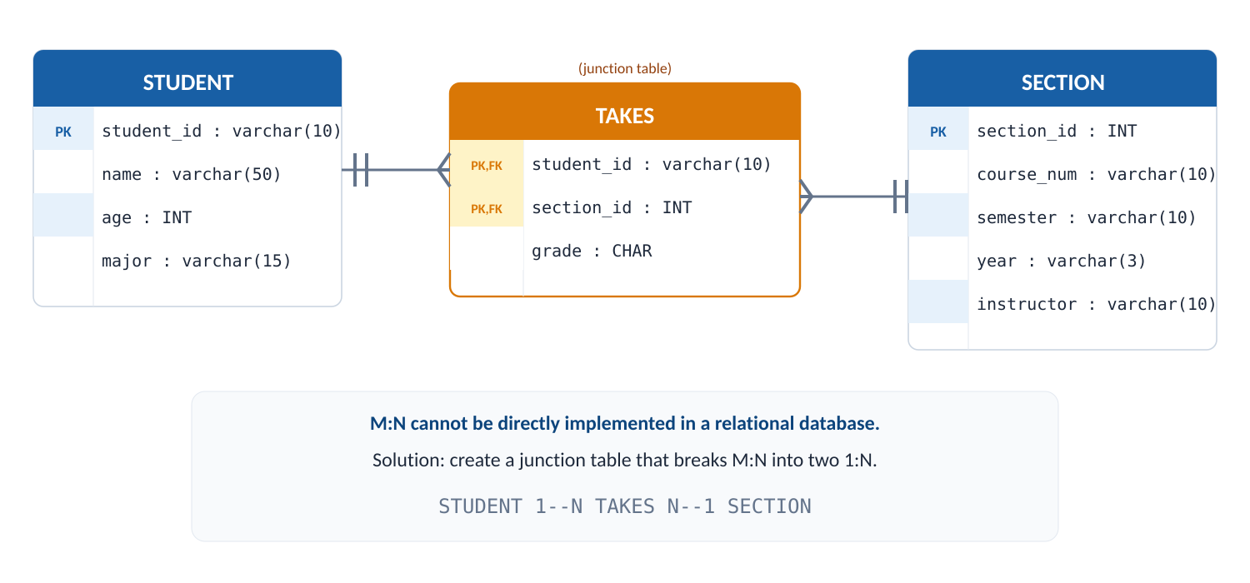
RELATIONSHIPS & CARDINALITY
Many-to-Many Relationship (M:N)
Many instances of entity A can be associated with many instances of entity B. Example: In a university, each student can take many course sections, and each section can be taken by many students.

Slide 19
RELATIONSHIPS & CARDINALITY
Participation Constraint
  Participation defines whether ALL or SOME instances of an entity must participate in a relationship.
  Total participation (mandatory)
    Every instance MUST participate. Example: Every section MUST be taught by a lecturer. Symbol: || (double bar)
  Partial participation (optional)
    Some instances MAY NOT participate. Example: Not every lecturer teaches a section. Symbol: O (circle)

Slide 20
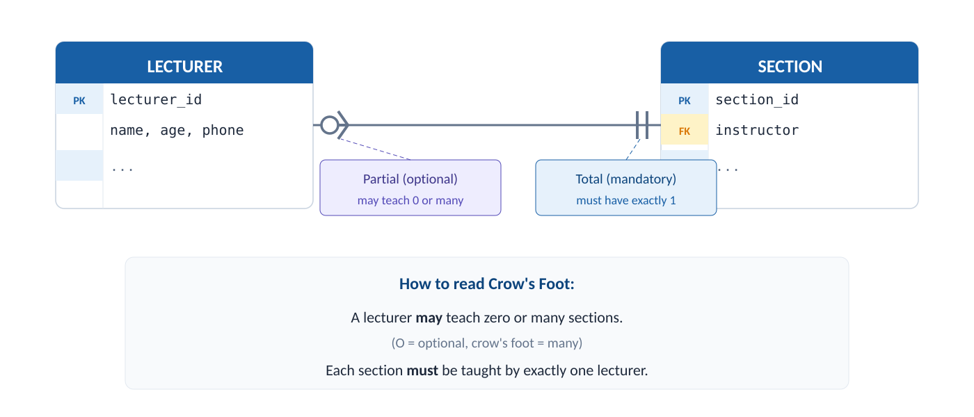
RELATIONSHIPS & CARDINALITY
Participation Constraint

Slide 21
SQL OVERVIEW
Data Definition Language (DDL)
  Used to define and modify database structure.
  Commands:
  CREATE - create database or its objects (tables, indexes, views)
  ALTER - modify the structure of an existing object
  DROP - delete an object from the database
  TRUNCATE - remove all records from a table

Slide 22
SQL OVERVIEW
Data Manipulation Language (DML)
  Used to manipulate data stored in the database.
  Commands:
  INSERT - add new data into a table
  SELECT - retrieve data from a table
  UPDATE - modify existing data
  DELETE - remove data from a table

Slide 23
SQL OVERVIEW
Data Control Language (DCL)
  Used to control user access rights to the database.
  Commands:
  GRANT - give users access privileges
  REVOKE - withdraw access privileges

Slide 24
Summary
Data Model - A data model is a collection of concepts to describe database structure. Three levels: conceptual (WHAT), logical (HOW), physical (WHERE).
Entity & Attributes - An entity represents a real-world object. Attributes describe entities and come in four types: key, composite, multivalued, and derived.
ERD Notation - Chen uses rectangles, ovals, diamonds. Crow's Foot lists attributes inside boxes and uses line symbols. Crow's Foot is the industry standard.
Relationships & Cardinality - Relationships connect entities with three cardinality types (1:1, 1:N, M:N). M:N requires a junction table. Participation can be total or partial.
SQL Overview - SQL has three categories: DDL (define structure), DML (manipulate data), DCL (control access)

Slide 25
exercise
UniLibrary is a university library system. Your task is to design the Entity-Relationship Diagram.
Requirements:
Students can borrow books from the library. Each student has a student ID, name, and department.
The library has a collection of books. Each book has an ISBN, title, author, and year published.
A student can borrow many books, and each book can be borrowed by many students (at different times).
Each borrowing record tracks the borrow date, due date, and return date.
The library has multiple branches. Each branch has a name and location. Each book belongs to one branch.

Slide 26
exercise
Your Tasks:
Identify all entities and their attributes.
Determine the relationships and cardinality.
Draw the ERD using Crow's Foot notation.

Slide 27
References
Session 2
Murach, J. (2023). Murach's MySQL, 4th Edition. Mike Murach & Associates. Chapter 10.
Elmasri, R. & Navathe, S. (2015). Fundamentals of Database Systems, 7th Edition. Pearson. Chapter 3.

